Slide 1
CARDS 101: Introduction to CARDS (Claims and Regulatory Data System)
CARDS Enhancements 2025
State of Nevada Workers’ Compensation Section (WCS)

Slide 2
CARDS 101: Introduction to CARDS
TRAINING MODULE
Supporting the CARDS 2025 Enhancements Release

Slide 3
Overview
Objectives
Training Course: CARDS 101: Introduction to CARDS
Audience: External CARDS Users
Prerequisites: None
Course Length: 1 hour
At the completion of this course, training participants will be able to register an account, have a general understanding of how to navigate through the application, and learn how to submit an Online Complaint through the CARDS application.

Slide 4
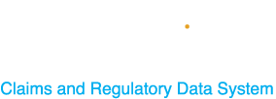
What is CARDS?
CARDS, which stands for “Claims and Regulatory Data System”, is a data collection system for the State of Nevada Workers’ Compensation Section.
For external users in the application, the main function has previously been for indexing claims, running reports, and maintain Insurer and TPA contact information up to date.
With the enhancements to the application, the features will extend to other functionality including, but not limited to; submitting webforms, increased reporting capabilities, processing payments, and improvements to the auditing process.

Slide 5
Modules
Registration
User Types
User Permissions and the Role of Account Admin
CARDS Navigation
CARDS Features
Complaint Webform

Slide 6
CARDS Registration
HOW TO REGISTER A NEW ACCOUNT IN THE CARDS APPLICATION

Slide 7
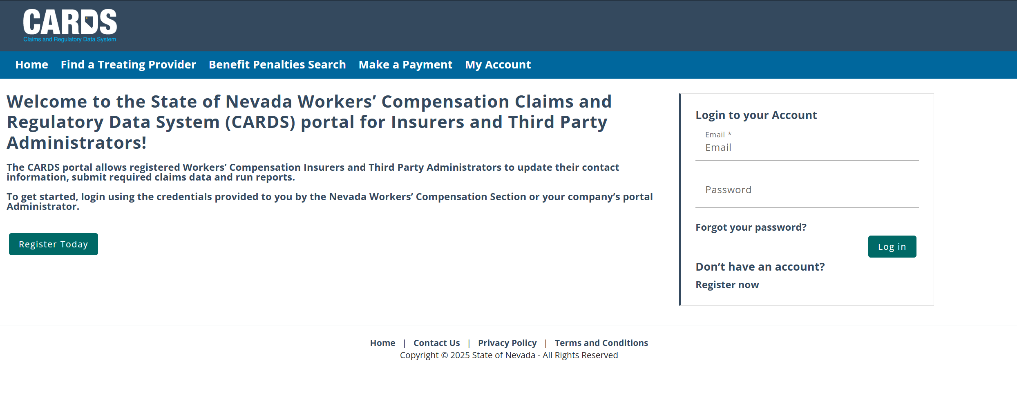
CARDS Registration
NAVIGATING TO THE CARDS WEBSITE AND COMPLETING ACCOUNT REGISTRATION
Step 1: Navigate to the CARDS site (environment will be available starting June 2nd )
Step 2: Select “Register Today” or “Register now” to initiate the registration process
2
2
Notes:
You should note that the production environment will not be live and available for use until June 2nd. After go-live, we would recommend updating this slide to include that link in Step 1.

Slide 8
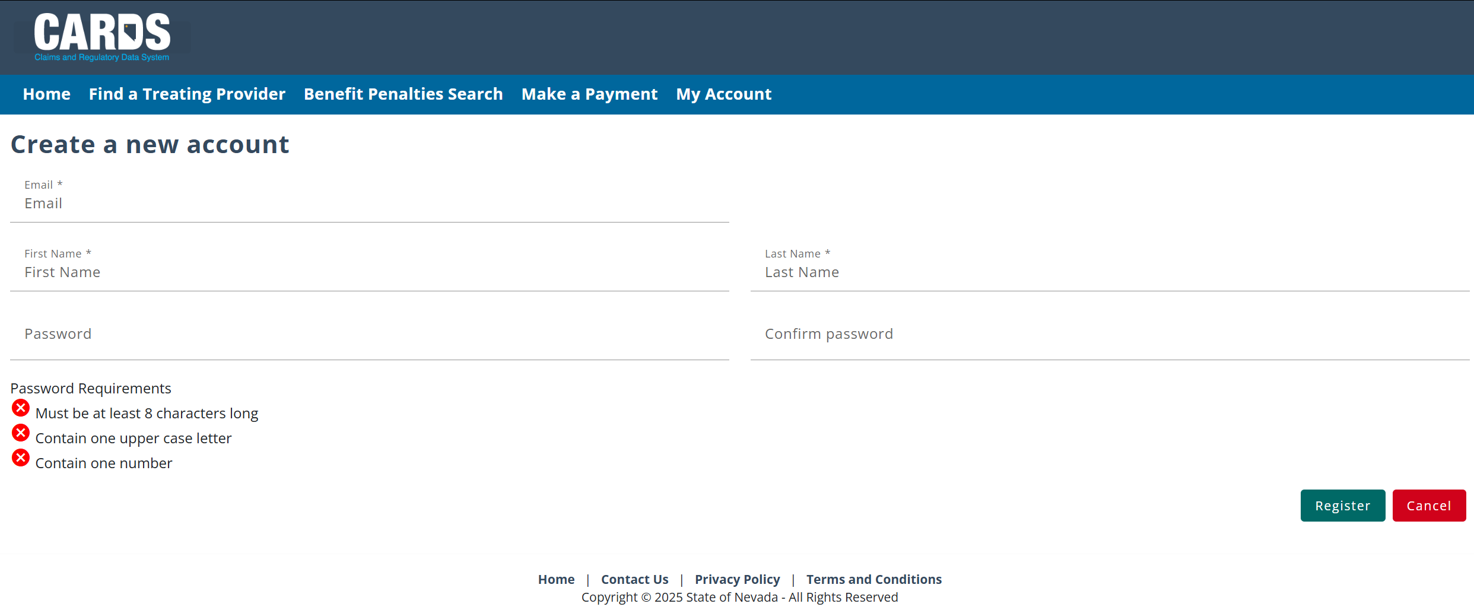
CARDS Registration
NAVIGATING TO THE CARDS WEBSITE AND COMPLETING ACCOUNT REGISTRATION
Step 3: Enter new log in information
Note: Email may be used for email notifications, so be sure to use an active email inbox

Slide 9
CARDS Registration
NAVIGATING TO THE CARDS WEBSITE AND COMPLETING ACCOUNT REGISTRATION
Step 4: Activate your account through the email link
Note: Email will be sent by “no-reply@nv.gov”

Slide 10
CARDS Registration
NAVIGATING TO THE CARDS WEBSITE AND COMPLETING ACCOUNT REGISTRATION
Step 5: Log into the CARDS site using the credentials provided at the time of registration

Slide 11
CARDS Registration
NAVIGATING TO THE CARDS WEBSITE AND COMPLETING ACCOUNT REGISTRATION
Step 6: Ensure your account is associated with an Entity*. If you have not been added to an entity group prior to activating your account, upon login, the homepage appear like the following:
Reach out to the account administrator of the entity you wish to join to be added to the group. The External Users module will review adding users and setting permissions for each user. If you are the administrator of the account and have not been added to the entity group, reach out to WCS (CARDS@dir.nv.gov or call 702-486-9080) to be added to your entity
*Entities are the parent account that external user can be linked under. CARDS has the following entity types:
(1) Insurer, (2) Third Party Administrator, (3) Clinical Practitioner, (4) Law Firm
Notes:
If you all have additional information about how external users become account admin and how that process is handled by the internal team, this would be a good place to speak to that and possibly include an additional slide with that information.

Slide 12
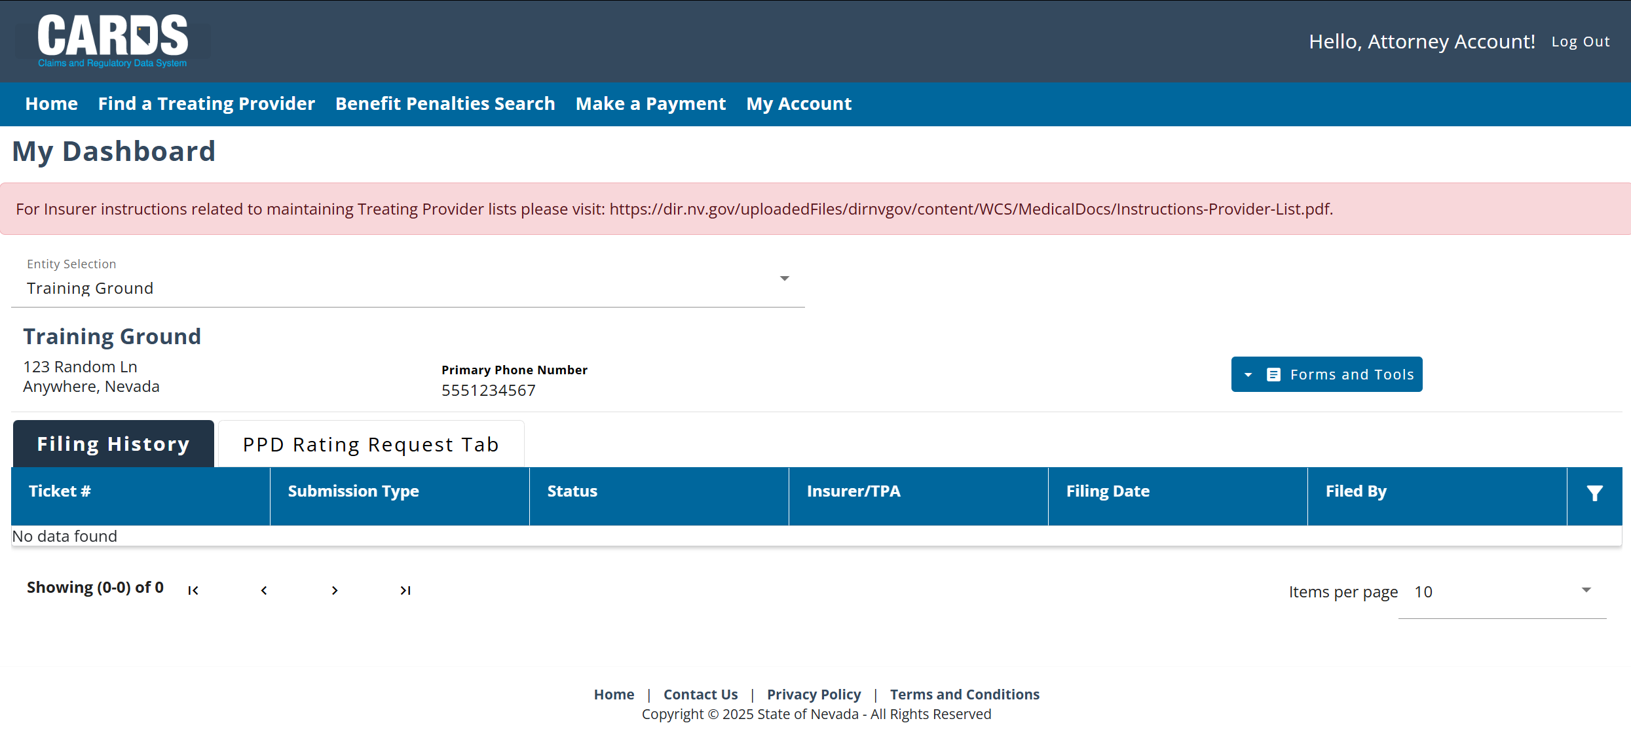
CARDS Registration
Note: The account in the example is linked to a Law Firm Entity
NAVIGATING TO THE CARDS WEBSITE AND COMPLETING ACCOUNT REGISTRATION
Once you are associated with an entity, the homepage will look as follows:
Depending on the type of entity you are related to (Insurer, TPA, Clinical Practitioner, Law Firm), the homepage will vary with what features are displayed. The External Users module will review some of these differences.

Slide 13
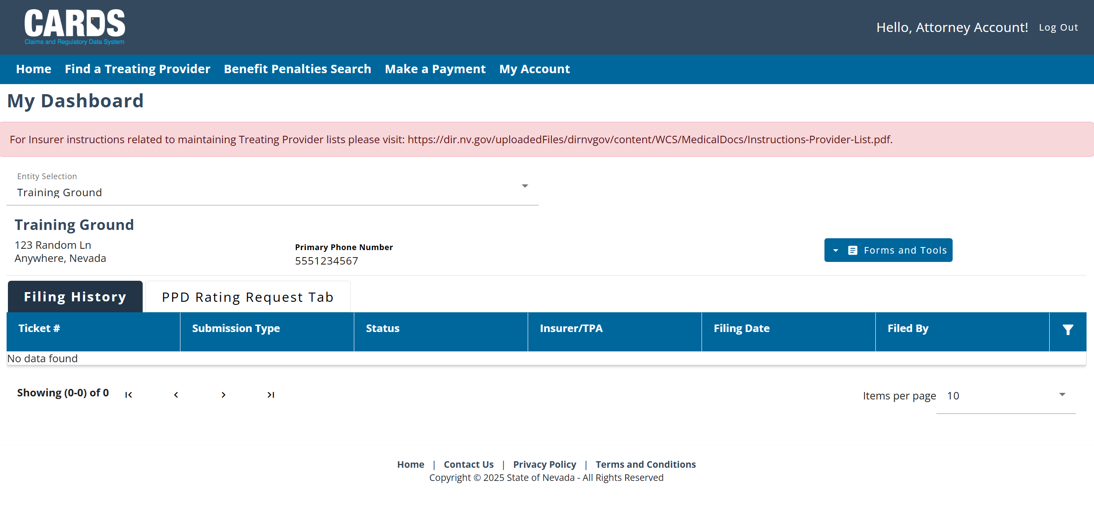
Changing Your Password
CHANGING YOUR CARDS ACCOUNT PASSWORD
This function is always visible on the menu bar, but only available to authenticated users.
Notes:
Explain here the difference between authenticated and non authenticated users. Authenticated users have completed the registration process and have their own account and login credentials. Unauthenticated users do not. Unauthenticated users are still able to access certain functionality in CARDS such as filing a complaint without a login. That will be covered later in the presentation.

Slide 14
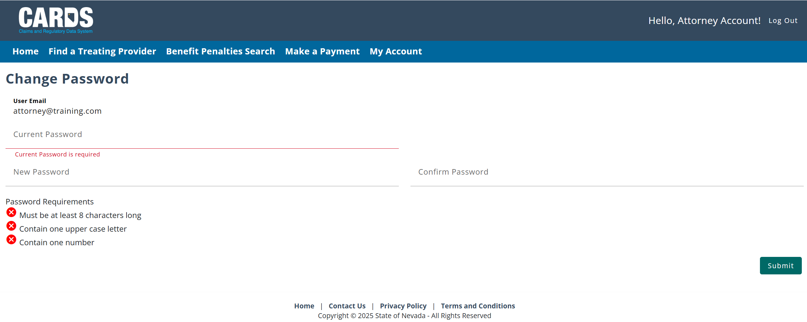
My Account
CHANGING YOUR PASSWORD
Resetting your password

Slide 15
User Types
EXTERNAL USER TYPES IN THE CARDS APPLICATION

Slide 16
User Types
Objectives
External User Types
Insurer
Third Party Administrators (TPAs)
Clinical Practitioner
Attorney
At the completion of this module, training participants will be able to identify each of the external user types available in the CARDS system.
Notes:
We will start with the homepages for each external user type.
Each homepage layout varies based on the user type and it is important to note that only one user type may be assumed at a time, and once a user type is selected for an account, it cannot be changed.

Slide 17
Which User Type Are You?
CARDS USER TYPES
Insurers: Already included as users in the CARDS application. Insurer users will be associated with at lease one Insurer entity and have may have a relationship to TPAs.
Third Party Administrators (TPAs): Already included as users in the CARDS application. TPA users will be associated to their TPA entity and can be granted permissions to perform actions on behalf of an Insurer.
Attorneys: New user type in the CARDS system. Attorneys are associated with a Law Firm entity, submitting forms on behalf of injured workers.
Clinical Practitioners: New user type in the CARDS system. Their entity will be the Clinical Practitioner Profile, they will be set up as admins and can have a few additional authenticated users on their account. Clinical practitioners will primarily use CARDS to submit evaluation forms for injured workers.
The next slides will be a quick overview of what’s included on the homepage of each user type.

Slide 18
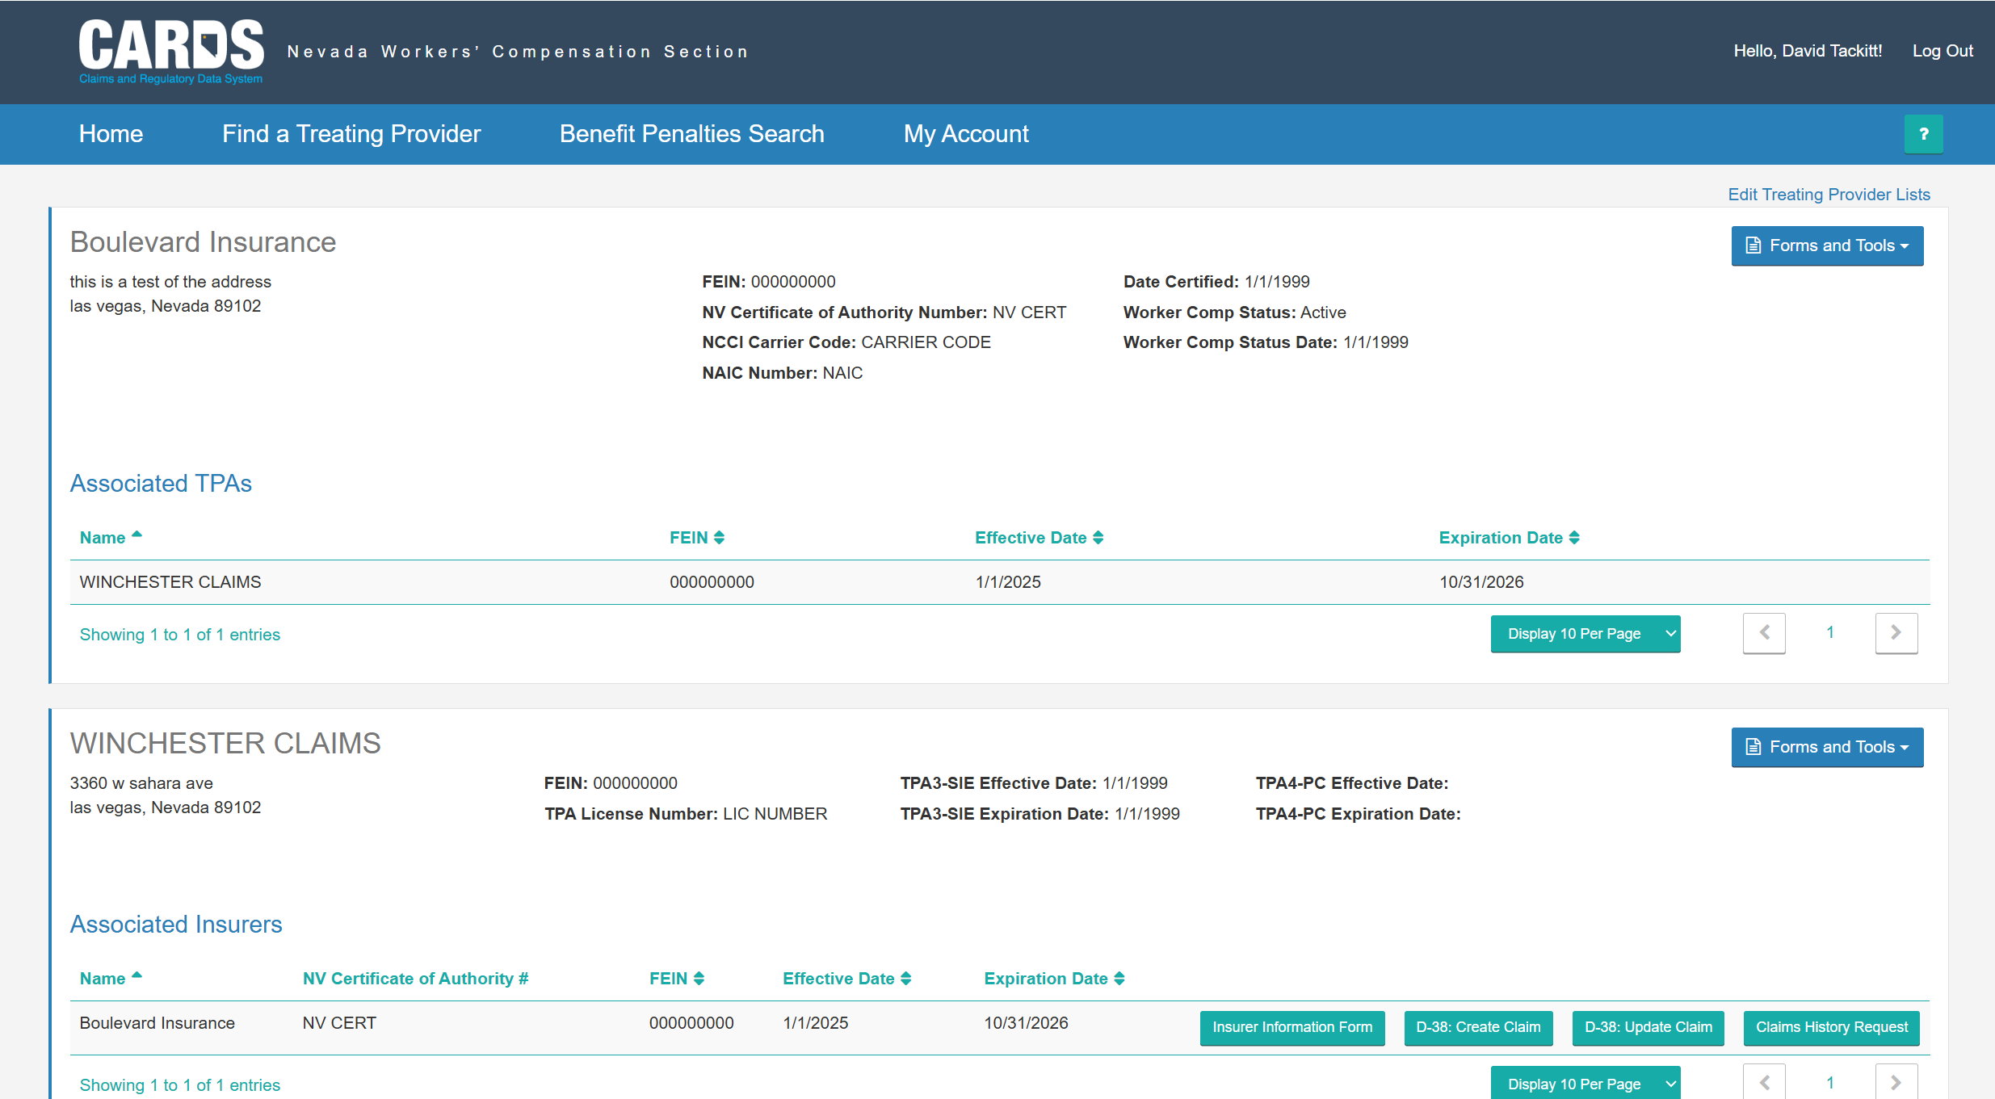
Current CARDS External Homepage
COMBINED INSURER AND TPA VIEW
Currently, Insurers and TPAs are treated as a single user type. The CARDS enhancements includes splitting these user… The current application has a single homepage for both users.
See the next slides for how these two users will interact with the application moving forward + the two new users.

Slide 19
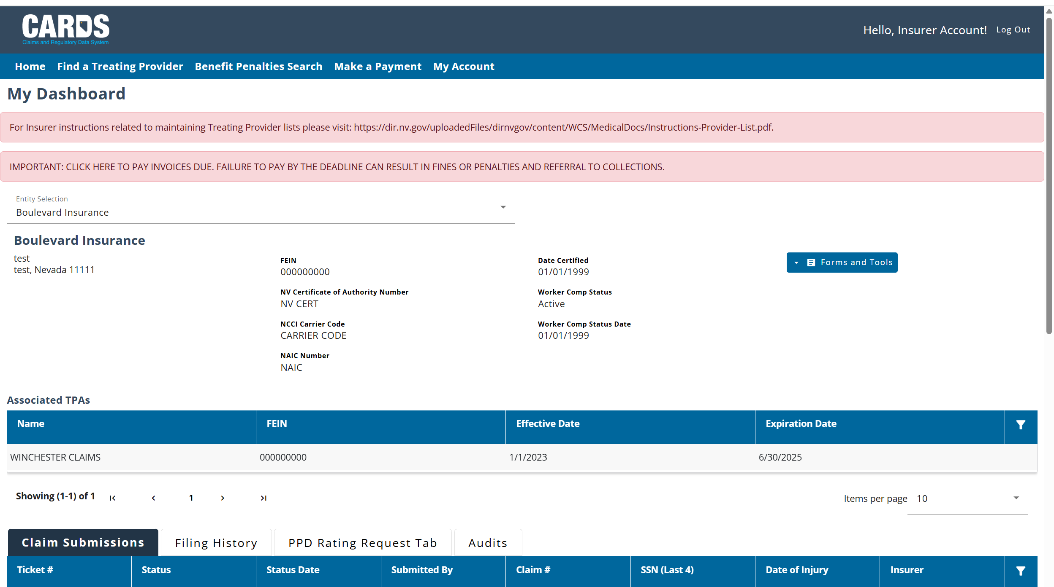
Insurer Homepage
Forms and Tools Menu
Entity Selection
Entity Detail Block
Associated TPAs
Filtering Tool enables searching larger tables
Tabs

Slide 20
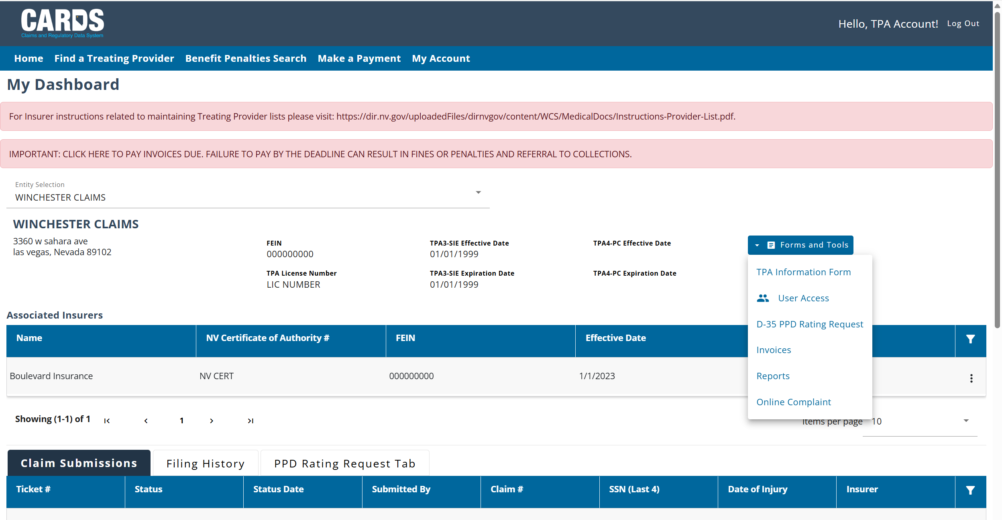
TPA Homepage
TPAs have additional options in the Forms and Tools Menu
Associated Insurers Section
Ellipses provide edit options
Notes:
The TPA Homepage closely mirrors the Insurer Homepage with the main differences being different options available in the Forms and Tools Menu and the Associated Insurers Section Replacing the Associated TPAs.
If a TPA user, they can perform actions on behalf of the Insurer by navigating to the Insurer’s entity Selection. We will review the differences in permissions for TPAs at a later date – will be included in the 201

Slide 21
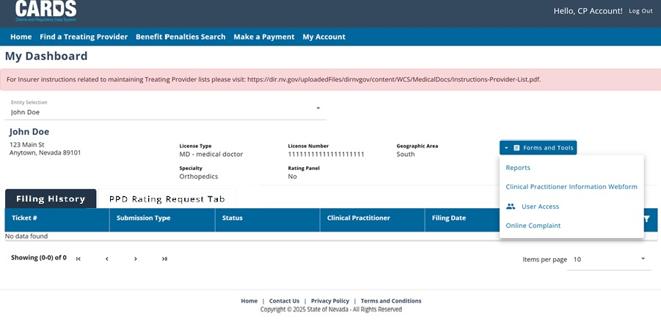
Clinical Practitioner Homepage
Note: Clinical practitioners and attorneys do not have the Claim Submissions tab

Slide 22
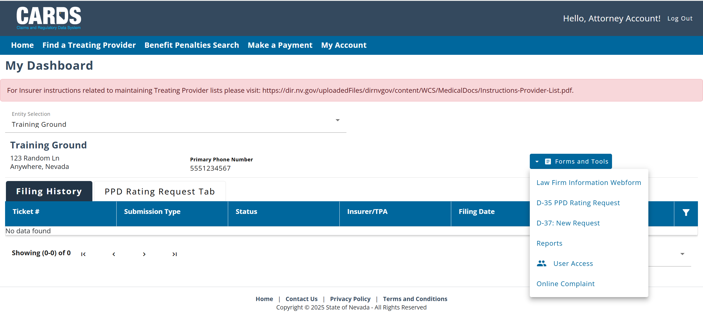
Attorney Homepage
Note: Options in the Forms and Tools menu vary based on both the User Type and Admin Access
Notes:
*Add box around User Access, segway into permissions*

Slide 23
User Permissions and the Role of an Account Admin
ACCESSING CARDS FUNCTIONS BY ROLE

Slide 24
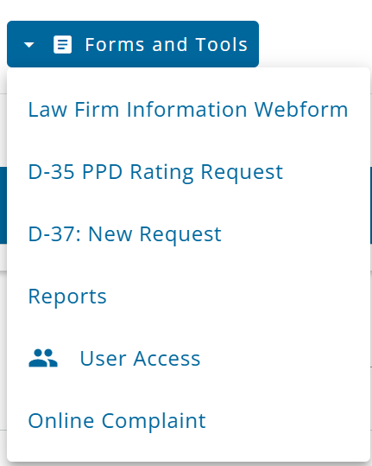
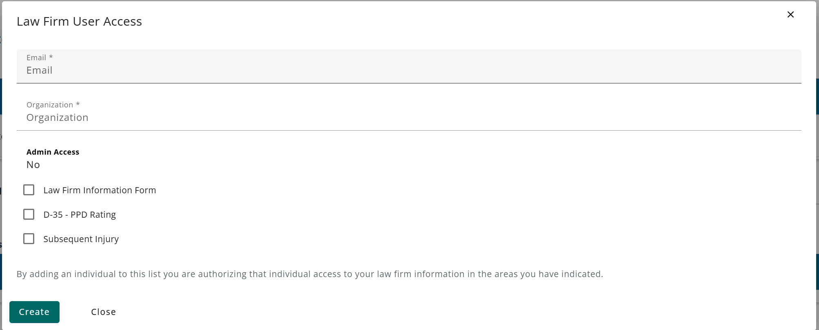
Account Admin
ACCOUNT ADMINS FOR ENTITY GROUPS
Each Entity group will have a designated admin user who will be responsible for setting permissions for each user that is added to the group. Admins can only be set up by the internal WCS staff, which will be done when the Entity is added to the CARDS application.
Indications that you are an Admin user:
Yes

Slide 25
User Permissions
CONTROLLING USER ACCESS BY ROLE
Setting user permissions allows account admin to control what CARDS functions individual accounts can access based on their role. Permissions can be set or updated from the User Management Page accessible through the Forms and Tools menu on the homepage.

Slide 26
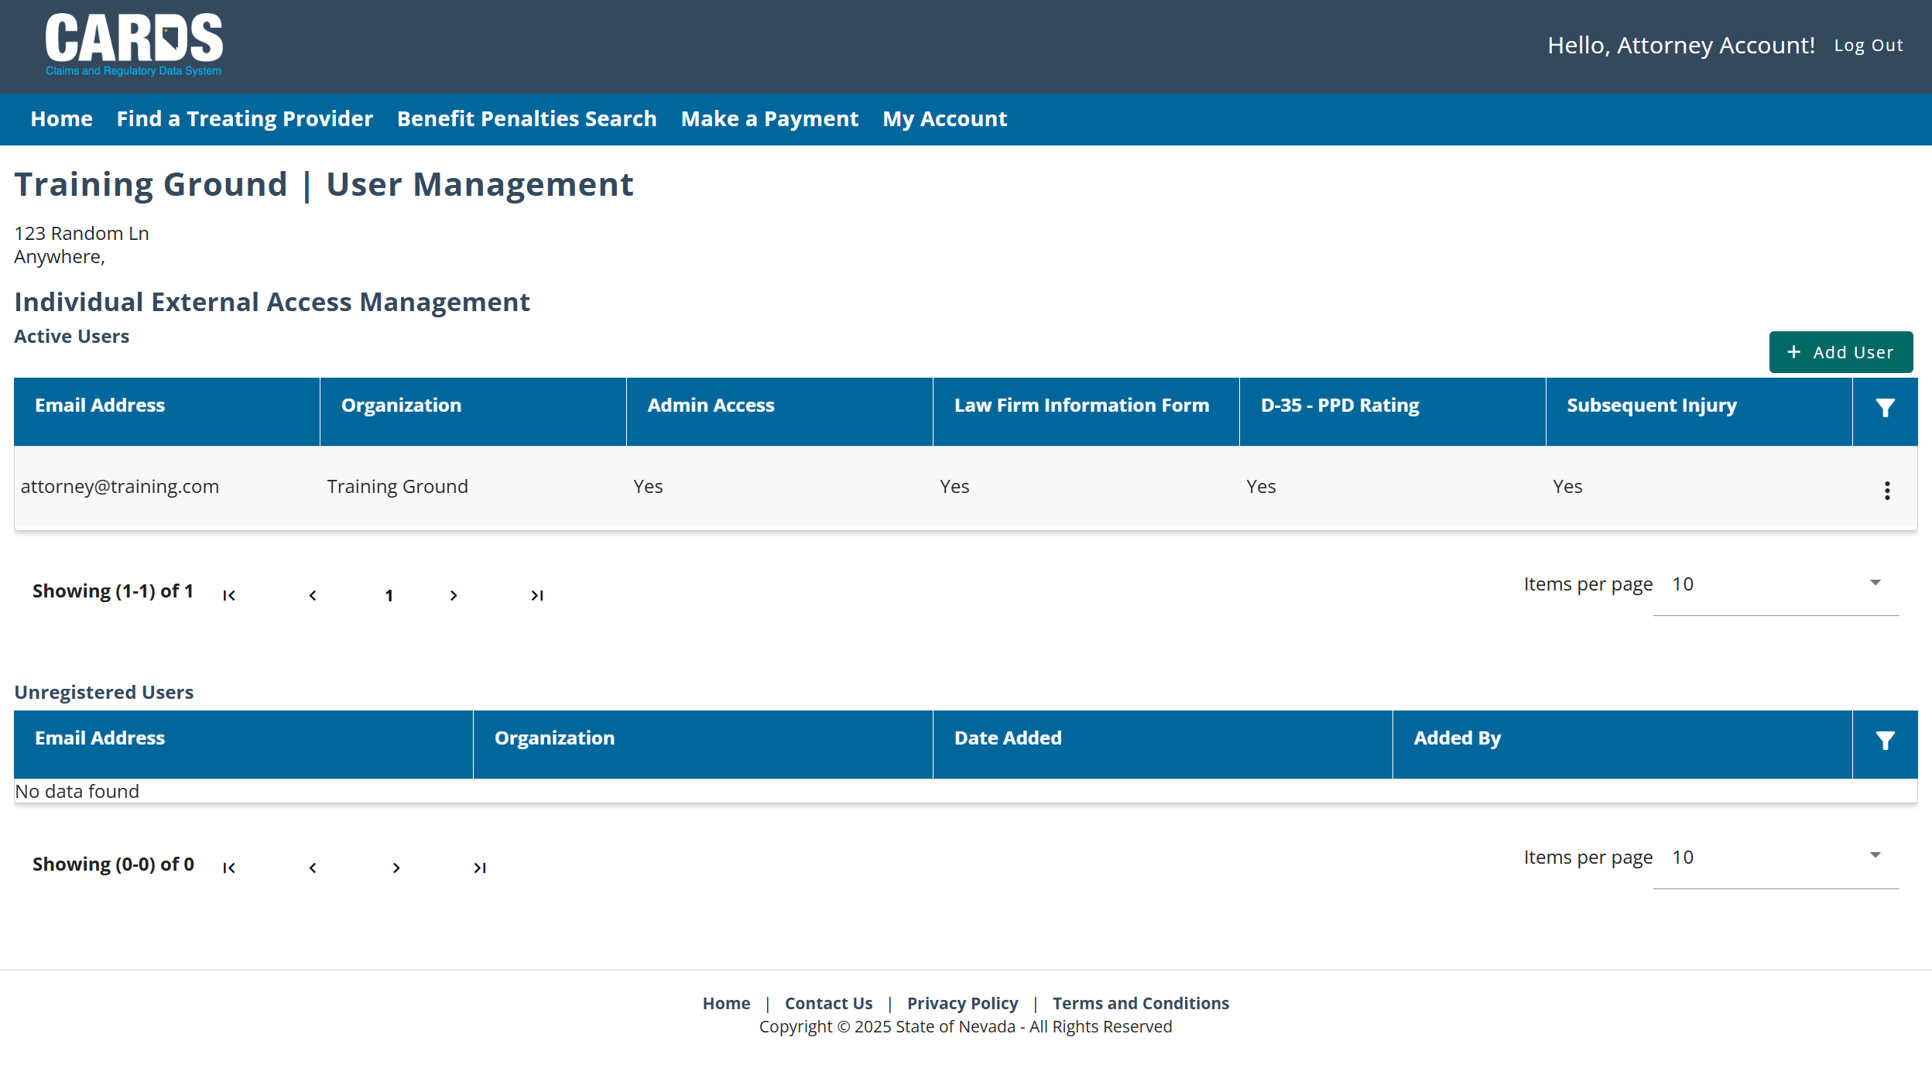
User Management Page
Adding a user, or editing an existing user using the ellipses allows admin to select specific permissions
The user management page allows administrators to control permissions.
Active and Unregistered User Tables

Slide 27
Permissions
Permissions set by the Admin user will drive what is available to the external user in the Forms and Tools Menu and on the External Dashboard.
Notes:
Review the registration slides to see if I note how to become an admin

Slide 28
CARDS Navigation
GENERAL NAVIGATION IN THE CARDS APPLICATION

Slide 29
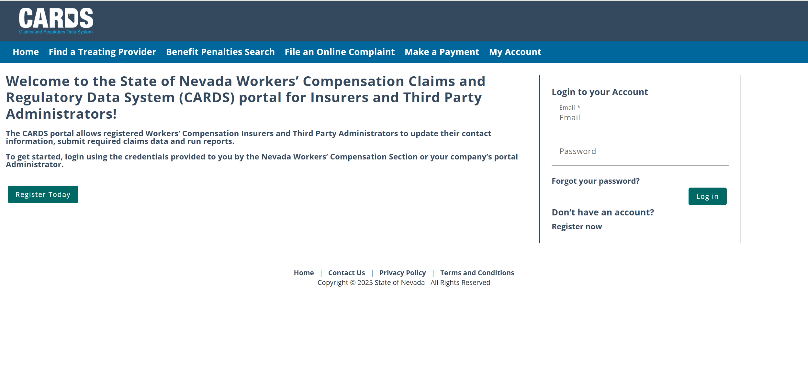
Menu Options
NAVIGATING THROUGH CARDS FEATURES
Notes:
Note that some of these options are available without having an account/being logged into CARDS (being an authenticated user) including the ability to file a complaint. It would be appropriate to note here that File a Complaint is only available on the menu when the user is not logged in, otherwise it is found in the Forms and Tools menu (this is shown in the Complaint section later in the deck)

Slide 30
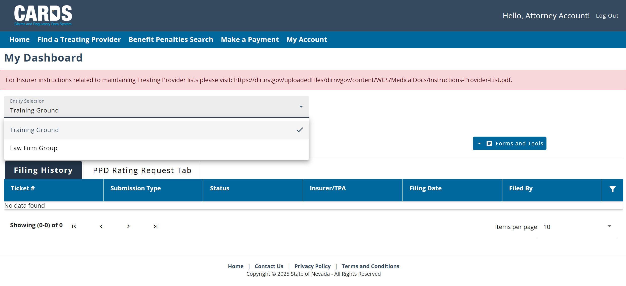
Entity Selection
FOR USERS WITH MULTIPLE ASSOCIATED ENTITIES
This is a drop-down menu at the top of My Dashboard

Slide 31
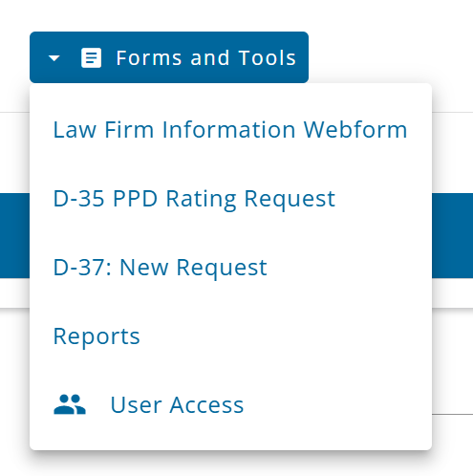
Forms and Tools
ACCESSING WEBFORMS AND UPDATING USER ACCESS

Slide 32
Filings and Webforms
ACCESSING DOCUMENTS AND SUBMISSIONS
Depending on permissions set for the user, the dashboard may include a few different tabs below the Entity Group Information Section. Claim Submissions and Audits will only apply to Insurer and TPA users, while the Filing History and PPD Rating Request Tabs can be applied to any user type.

Slide 33
CARDS Features
NEW FEATURES AVAILABLE IN CARDS
Notes:
Note: This is meant to act as a “sneak peak” for external stakeholders. Additional trainings will be available that go more in depth on specific features for the relevant user groups.

Slide 34
Overview of Features
NEW FEATURES ADDED TO CARDS
Claims Expenditure and Premium Data Webform
Assessment Invoicing
Payment Processing
D-35 Webform to Request a Rating Physician
Updated Insurer and TPA Information Webforms
Information Webforms for Clinical Practitioners and Law Firms
Audit Process Improvements
External Reporting
Treating Panel Enhancements
OD-8 Webform
Subsequent Injury (D-37) Webform
Claims Activity Webform
Complaint Webform
Notes:
Note: This is a great place to emphasize value added for external users and make callouts to how specific features will help them do their job more efficiently.

Slide 35
Complaint Webform
FILING A COMPLAINT IN CARDS

Slide 36
Filing a Complaint
TWO AVAILABLE OPTIONS
One of the new features of CARDS is the ability to file an online complaint. The form will gather basic information about the complainant and the details of the complaint, as well as asking a serious of questions to determine the nature of the compliant. Once the complaint form is submitted, it will be routed to the proper department to be worked depending on what the complaint relates to.
There are two complaint forms available within CARDS. For users with CARDS accounts, the complaint form is accessible using their Forms and Tools menu. For others who do not have an account, there is a publicly available complaint form located in the navigation ribbon on the log in page.
Users will be provided with a Complaint confirmation number that can be used for any future communications with the investigator assigned to the complaint.

Slide 37
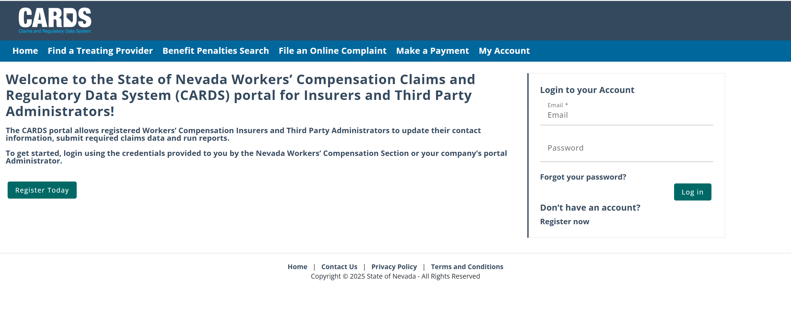
Accessing the Complaint Webform for Non-Authenticated Users
Non-authenticated users can access the complaint webform from the CARDS login page.

Slide 38
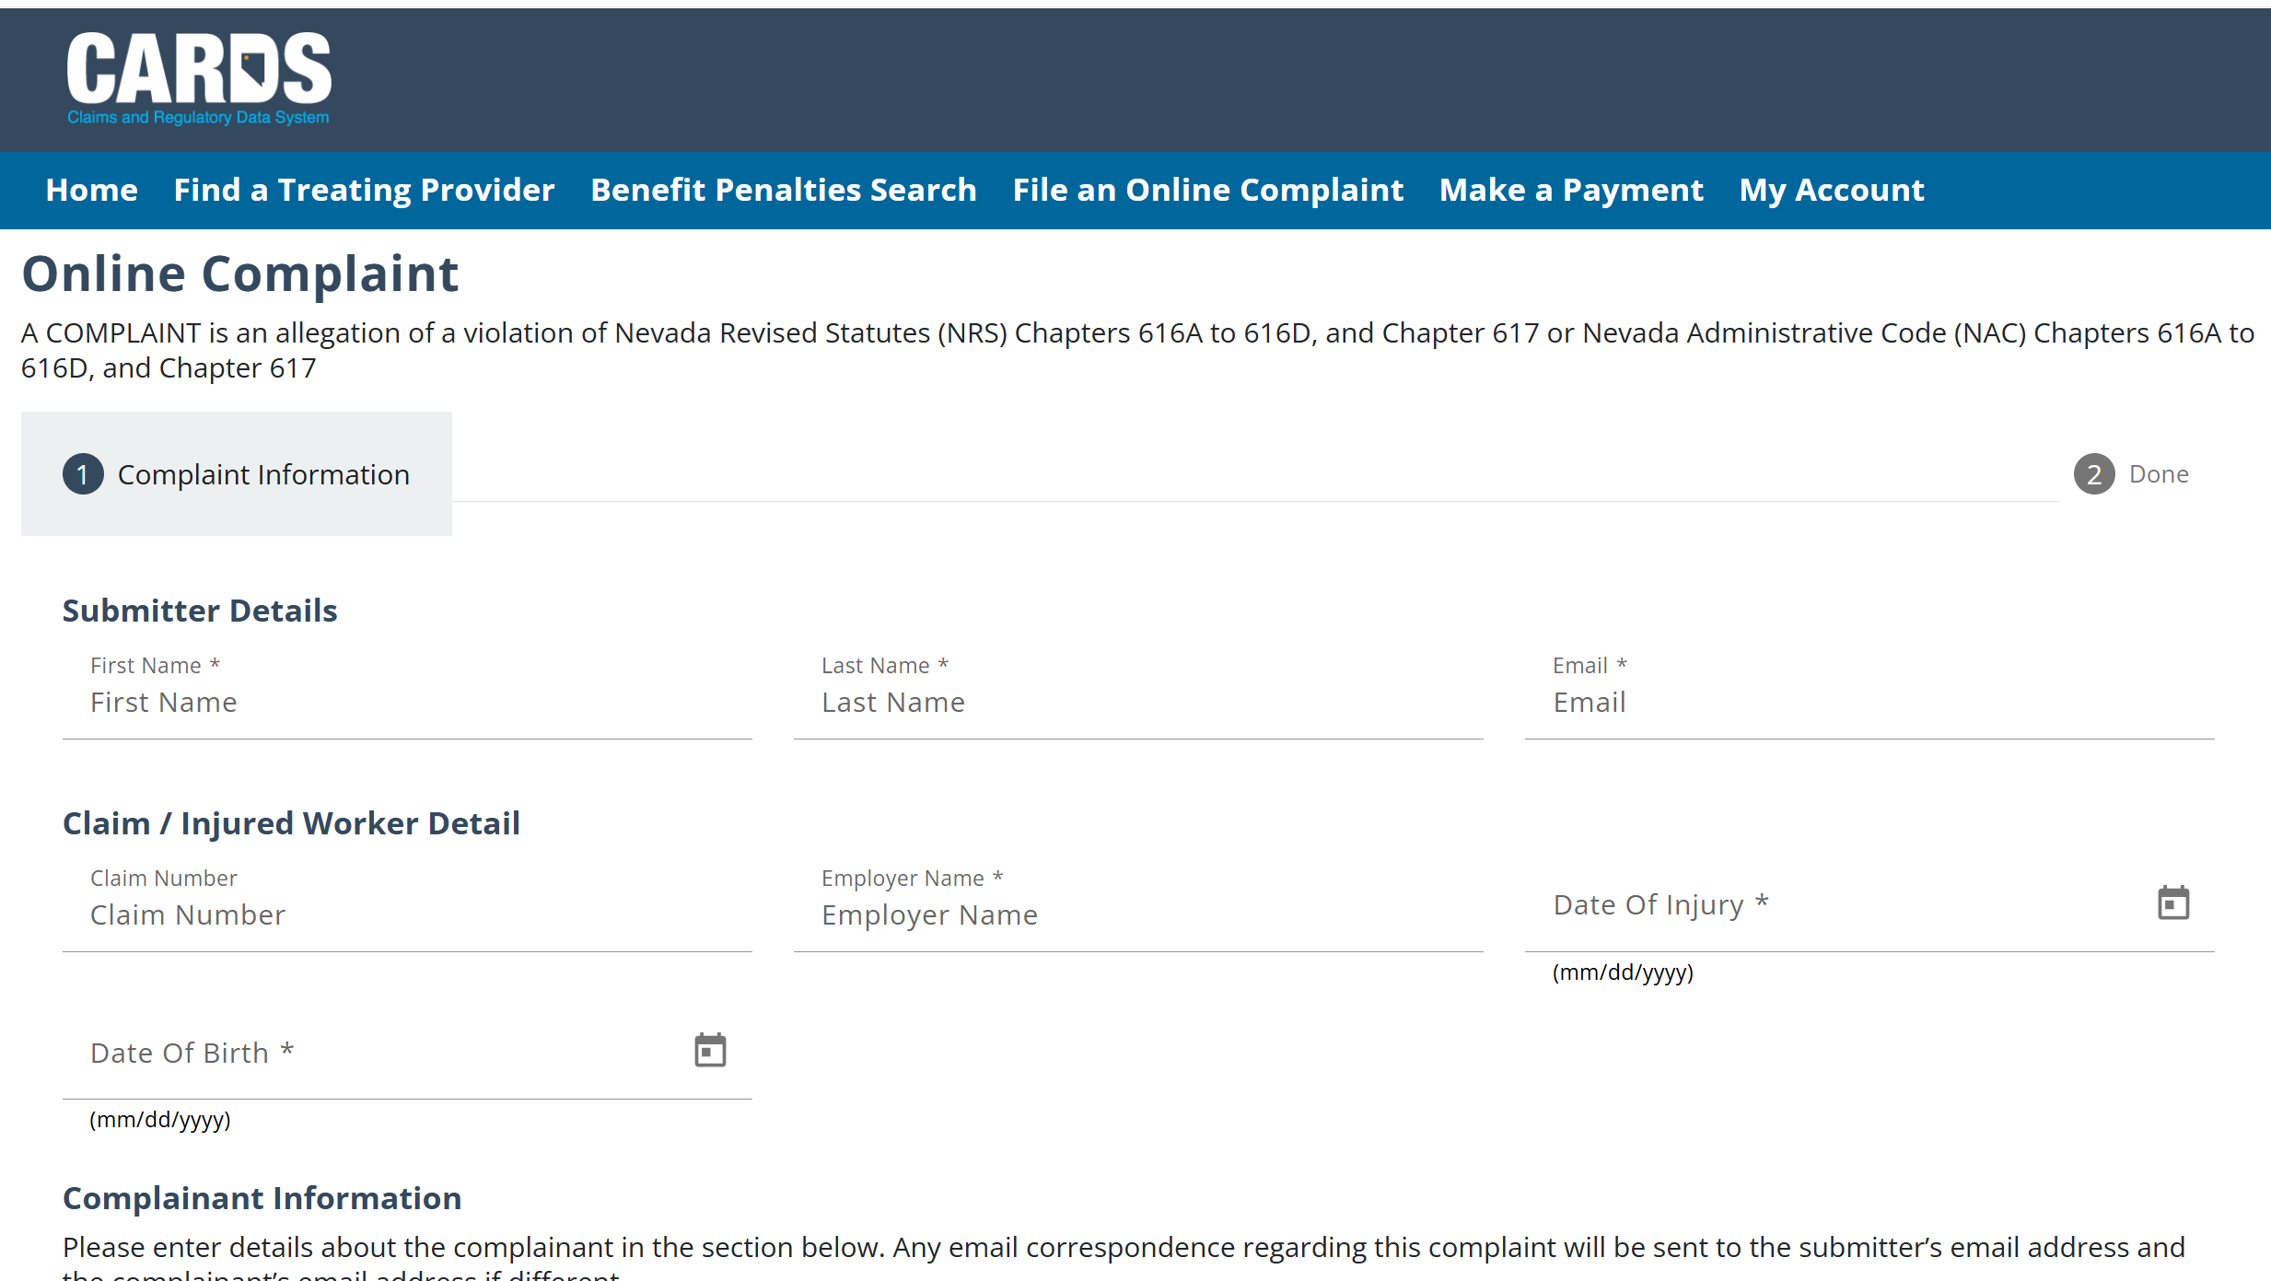
Complaint Webform for Non-Authenticated Users
For non-authenticated users, the webform will collect information about the user submitting the complaint, along with details about the complaint. This is followed by a series of questions to determine the proper unit to assign the complaint to.

Slide 39
Accessing the Complaint Webform for Authenticated Users
For authenticated users, the webform is available from the Forms and Tools Menu on the homepage.
Note: Users must be logged in to access this version of the Complaint Webform

Slide 40
Complaint Webform for Authenticated Users
NAVIGATING THE COMPLAINT WEBFORM
Search for a claim on the “Claim Search” step
Click “Continue with a Claim” if a claim is found or “Continue without a Claim” if one is not
Fill out required information in the “Complaint Information” step
Use Action Buttons when finished viewing or updating information
Use “Back” to return to claim search
Click “Cancel” if you do not want to submit a complaint
Click “Submit” when you are ready to upload the information
For authenticated users, the complaint webform is a series of three screens.
1
2
3

Slide 41
Questions?
CARDS 101: Introduction to CARDS
For any questions after this presentation, reach out to CARDS@dir.nv.gov
Notes:
Note: Replace the date placeholder with the date of the presentation to stakeholders

